Slide 1
System Identification:
Sparse Identification of Nonlinear Dynamics (SINDy)
Instructor: Mohammad Hasan
Office: 13-240
11/02/26
Notes:
Welcome and Introductions

Slide 2
Overview
Modeling Dynamical Systems
SINDy for a single ODE
SINDy for a system of ODEs
SINDy for PDEs

Slide 3
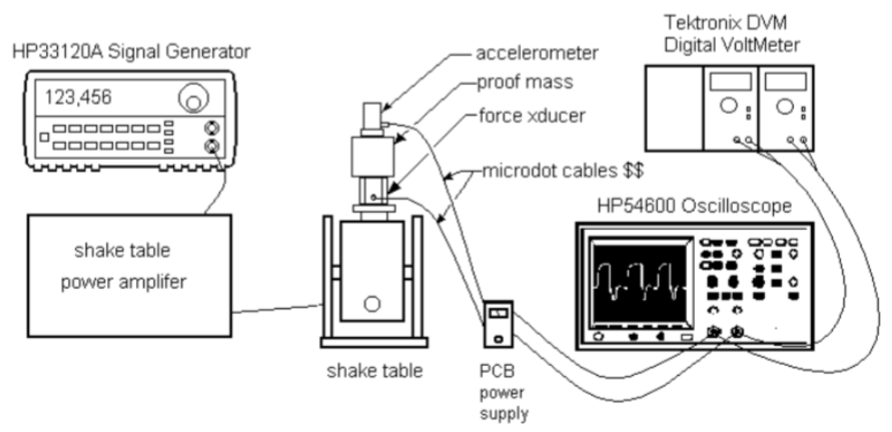
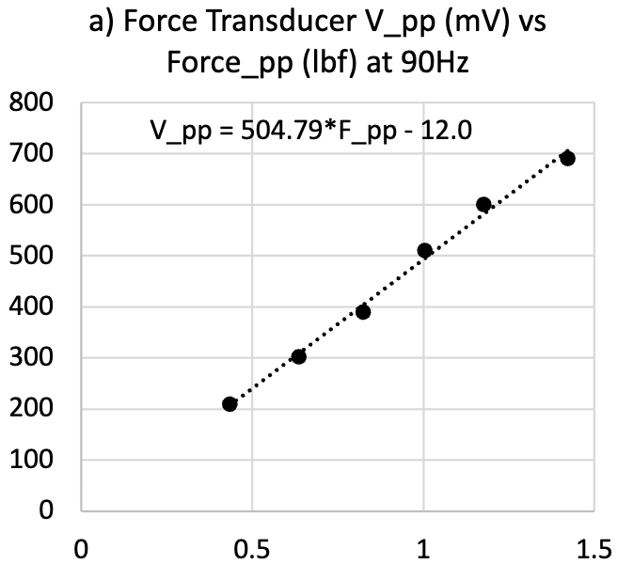
System Identification and Modeling
We have seen how to approximate data using ML models.
Example: linear regression, neural networks, etc.
Why do we create models?

Slide 4
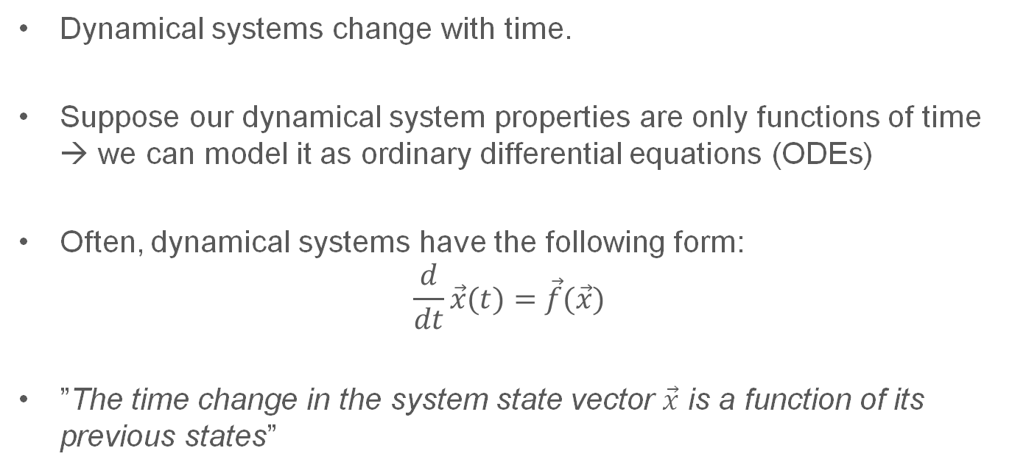
Modeling System Dynamics (ODE)
Dynamical systems change with time.
Suppose our dynamical system properties are only functions of time → we can model it as ordinary differential equations (ODEs)
Often, dynamical systems have the following form:
$$\frac{d}{dt}\vec{x}(t)=\vec{f}(\vec{x})$$
”The time change in the system state vector $\vec{x}$ is a function of its previous states”

Slide 5
Identifying a system EOM (ODE)

Slide 6
Generalized Linear Models for Identification

Slide 7
Candidate Library

Slide 8
Sparse Identification of Nonlinear Sytems (SINDy)

Slide 9
SINDy for Systems of ODEs

Slide 10
SINDy for Systems of ODEs

Slide 11
SINDy for Systems of ODEs

Slide 12
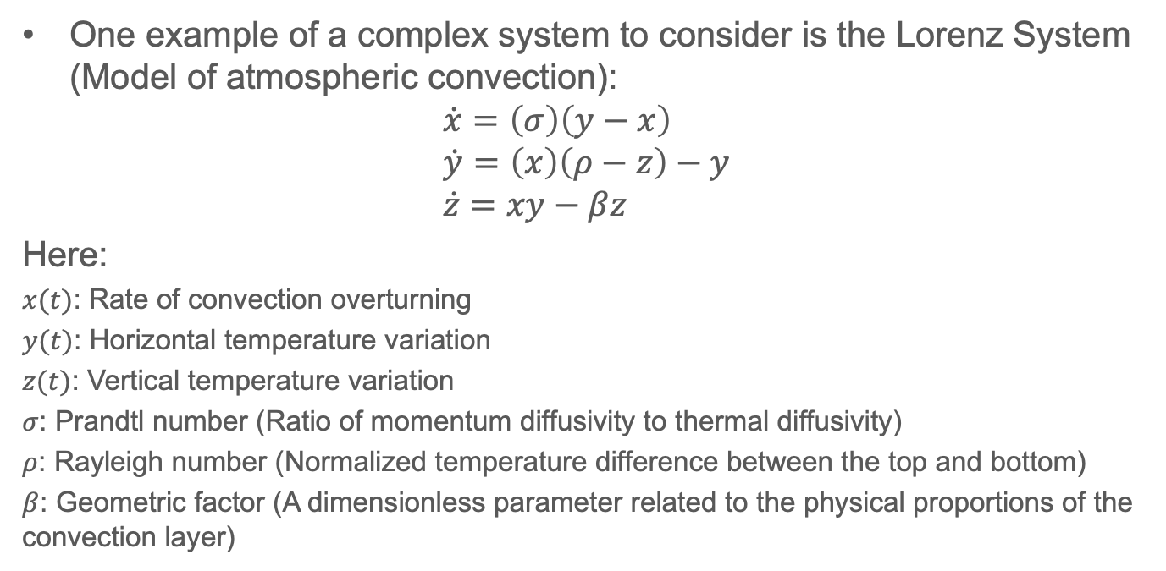
Example: SINDy for System of ODEs
One example of a complex system to consider is the Lorenz System (Model of atmospheric convection):
$$\dot{x}=\left(σ\right)\left(y−x\right) \\ \dot{y}=\left(x\right)\left(ρ−z\right)−y \\ \dot{z}=xy−βz$$
Here:
$x(t)$: Rate of convection overturning
$y(t)$: Horizontal temperature variation
$z(t)$: Vertical temperature variation
$σ$: Prandtl number (Ratio of momentum diffusivity to thermal diffusivity)
$ρ$: Rayleigh number (Normalized temperature difference between the top and bottom)
$β$: Geometric factor (A dimensionless parameter related to the physical proportions of the convection layer)

Slide 13
Lorenz System Library
Really, we need to find a system model starting by constructing an appropriate library.
Looking at the actual equation, the library should contain:

Slide 14
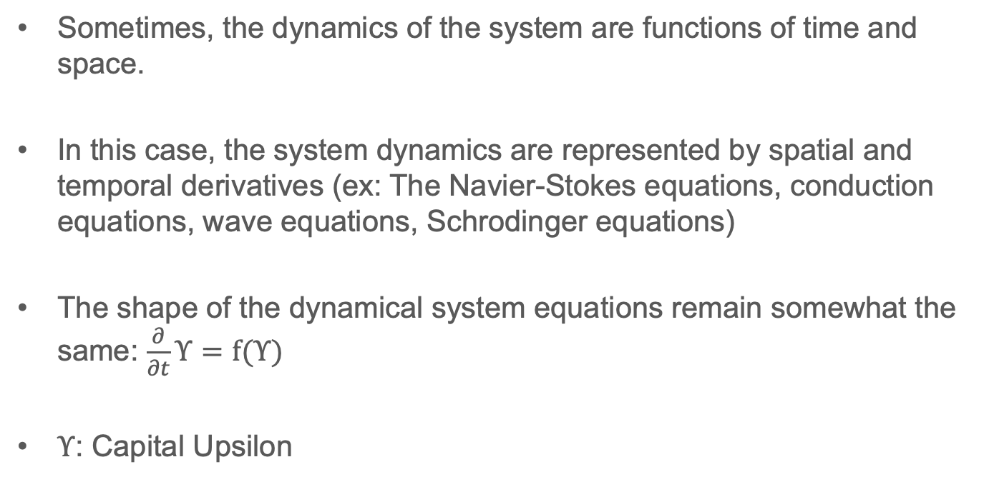
Discovering Partial Differential Equations (PDEs)
Sometimes, the dynamics of the system are functions of time and space.
In this case, the system dynamics are represented by spatial and temporal derivatives (ex: The Navier-Stokes equations, conduction equations, wave equations, Schrodinger equations)
The shape of the dynamical system equations remain somewhat the same: $\frac{∂}{∂t}Υ=f(Υ)$
$Υ$: Capital Upsilon

Slide 15
Discovering Partial Differential Equations (PDEs)

Slide 16
Discovering Partial Differential Equations (PDEs)

Slide 17
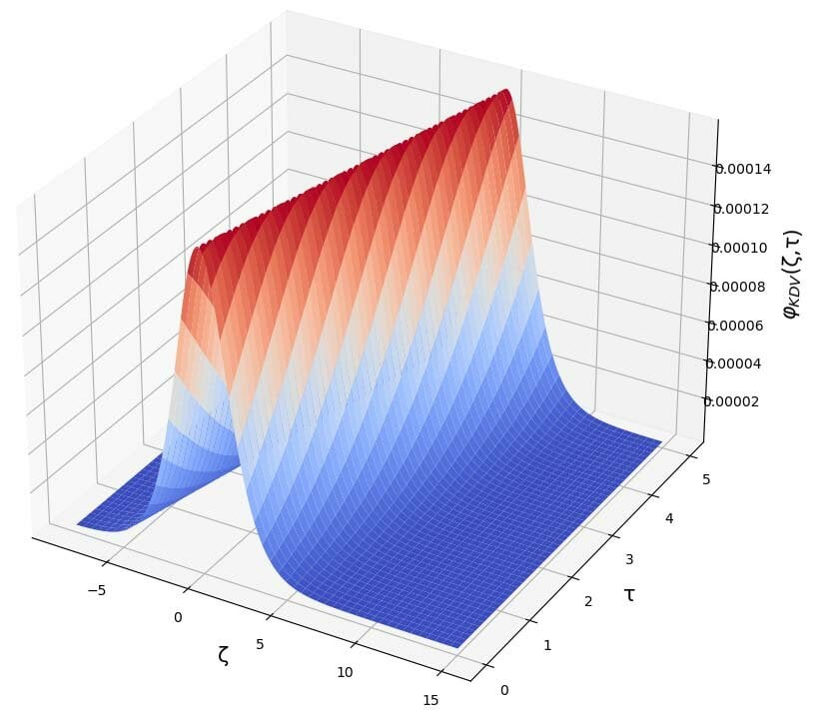
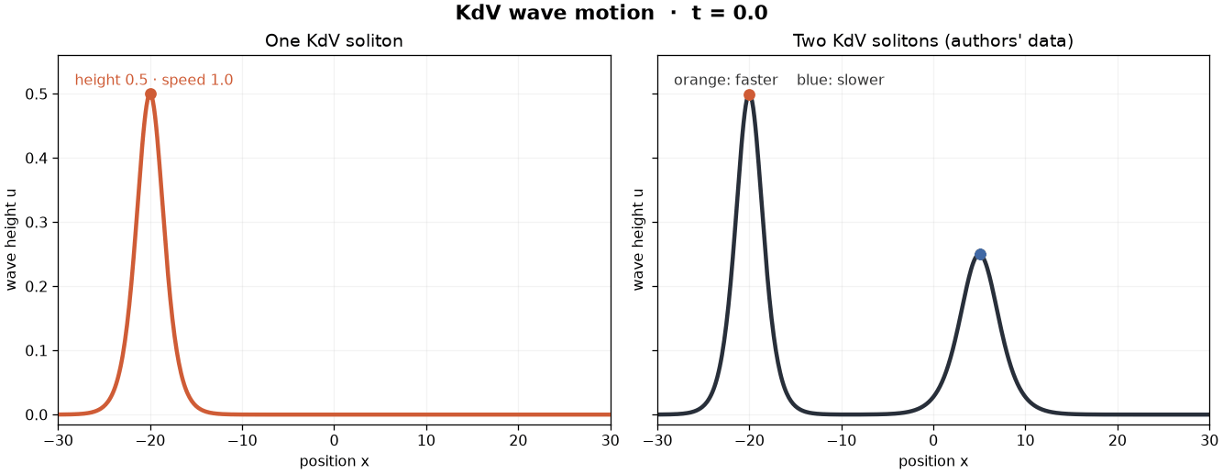
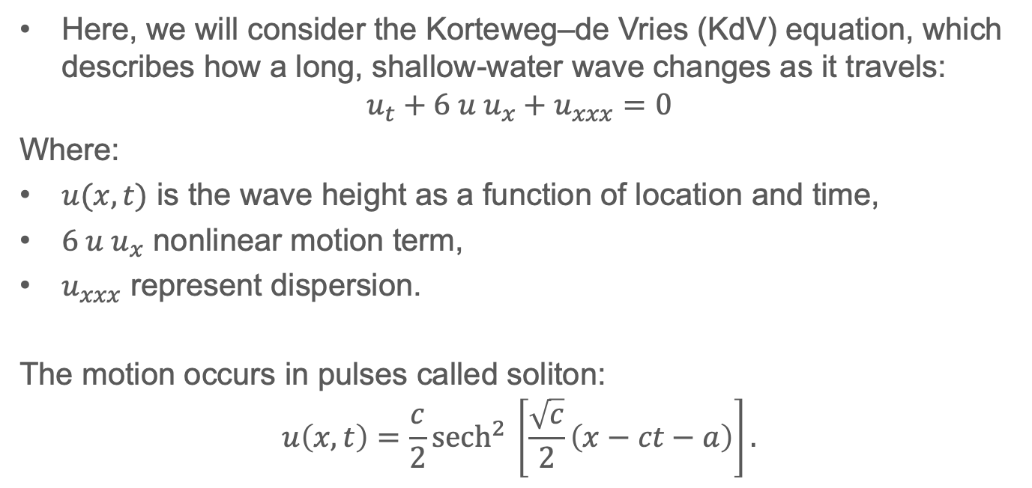
PDE Equation Example
Here, we will consider the Korteweg–de Vries (KdV) equation, which describes how a long, shallow-water wave changes as it travels:
$$u_{t}+6 u u_{x}+u_{xxx}=0$$
Where:
$u(x,t)$ is the wave height as a function of location and time,
$6 u u_{x}$ nonlinear motion term,
$u_{xxx}$ represent dispersion.
The motion occurs in pulses called soliton:
$$u\left(x,t\right)=\frac{c}{2}{sech}^{2}{​}\left[\frac{\sqrt{c}}{2}\left(x−ct−a\right)\right].$$

Slide 18
Conclusion
Differential equations can be constructed from raw data.
SINDy is one approach of system identification that uses a library of functions and generalized linear regression to find the EoM. (ODE or PDE)
Regularization can be used to create sparse representation for system identification.
Noise management strategies are needed when taking time derivatives to reduce model degradation.
Notes:
EoM: Equation of motion

Slide 19
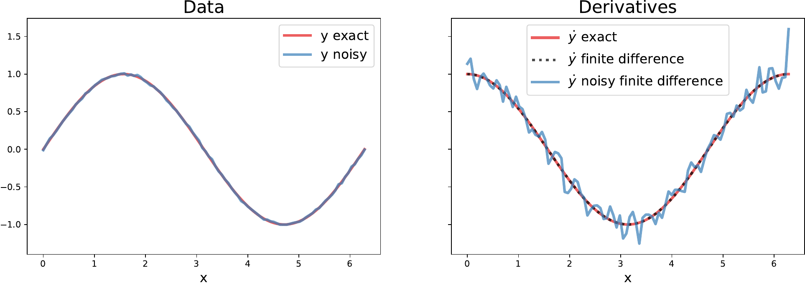
Nuances For SINDy
SINDy can be used for systems that are higher derivative of time (for example, 2nd order in time).
Derivatives are tricky. Taking numerical time derivatives is a noise-amplifying process.
Higher order derivatives = more noise.
Too much noise will degradation of model quality.
https://pysindy.readthedocs.io/en/latest/tips.html

Slide 20
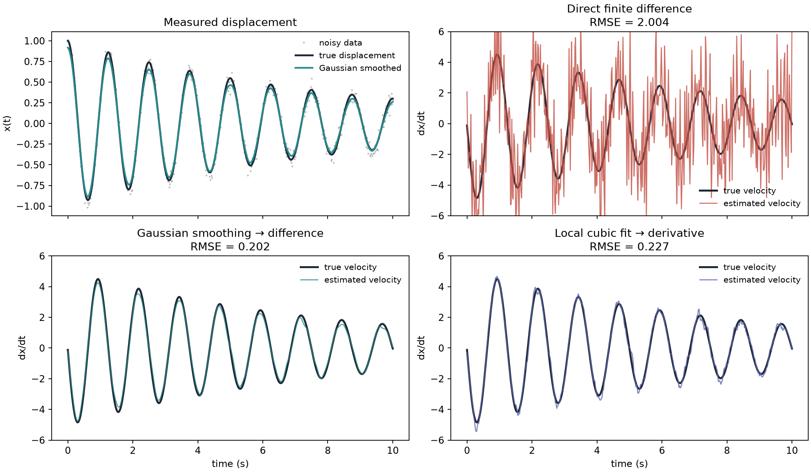
Nuances For SINDy
Options to improve performance for when taking time derivatives:
    Apply a smoothing filter.
    Fit a local polynomial to the data and apply derivative to the polynomial.

Slide 21
References
Data-Driven Science and Engineering, Machine Learning, Dynamical Systems, and Control. S. Brunton and J. Kutz, Second Edition. Section 7.3.
https://pysindy.readthedocs.io/en/latest/tips.html

Slide 22
Extra notes

